Slide 1

Basics of Neural Network Programming
Logistic Regression
Gradient descent
deeplearning.ai
Notes:
In the ML world (unlike the math world), loglog means natural log.

Slide 2
About this slide
In this slide we will discuss how to compute derivatives to implement gradient descent for logistic regression.
Key takeaway will be what we need to implement.
Key equations for gradient descent in logistic regression.
We will use computation graph. Little bit of overkill but we need to get familiar with it for upcoming full fledge networks.

Slide 3

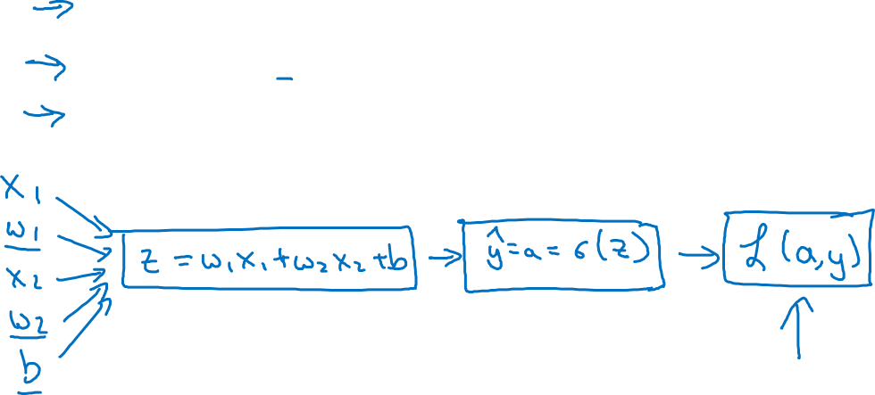

Logistic regression recap
$$z= w^{T}x+b$$
$$\hat{y}=a= σ(z)$$
$$ℒ\left(a,y\right)=−(y\log{(a)+(1−y)\log{(1−a))}}$$
Notes:
Toy Example:
Here, we discuss the loss for one example. We use only 2 features.
We use x1,w1,x2,w2, b fopr computing z & than we compute sigma of z to compute y hat. & than we compute loss.
We want to modify the parameters b & w in order to reduce the loss, using forward & backward computations.

Slide 4
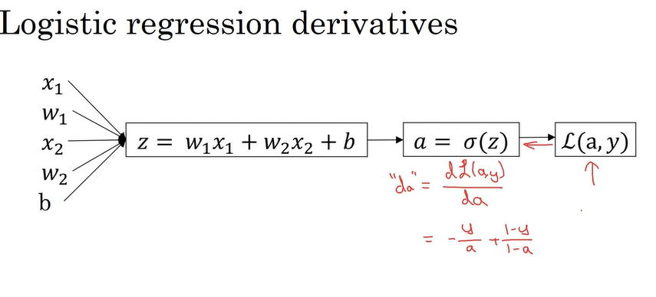
Logistic regression derivatives 1
Notes:
1- Try to take derivative of loss with respect to variable a as a self exercise. In code, we use da
We have just taken the formula of loss function –y loga + 1-y(log(1-a)) and took its derivative with respect to a to get dl/da which we call da

Slide 5
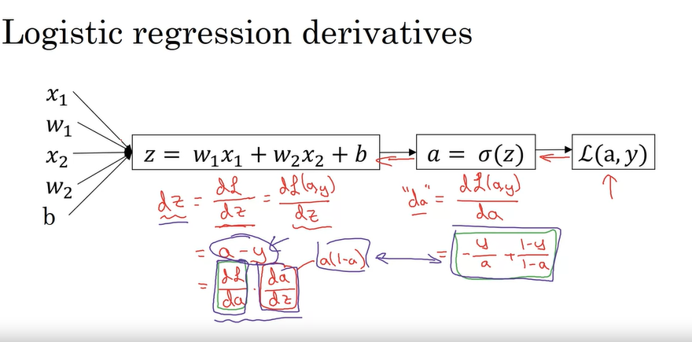
Logistic regression derivatives 2
Notes:
Using the da thing (bold), we can compute dz , did all the derivation sin rough notes.
Here we are representing dz = dl/dz by using chain rule:
dz/dl = (dl/da).(da/dz)
Where as this da/dz can be calculated using formula a(1-a) & the other quantity by –y/a + 1-y/1-a
When we substitute these 2 formulas, we get the value a-y

Slide 6
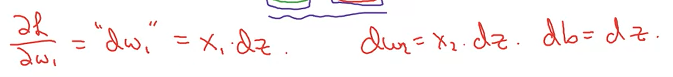
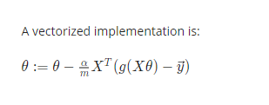
Logistic regression derivatives 3-The final step in backpropagation is to go back & compute how much we need to change w & b
Notes:
Final Step in BP:
To compute how much we need to change w & b.
We compute the derivative of loss with respect to weights , we call it dw1 for our first input weight & dw2 for the 2nd weight.
Db = dz since this is not multiplying with anything
I have also added the machine learning course formula for reference.

Slide 7

Question: How Dw1 is equal to x1 times dz
This can be solved using chain rule.
Now dw1 is basically the derivative of loss function wrt to w1.
With chain rule we can write it as : dl/dw1 = dz/dw1 * dL/dz
So we already have the value of dl/dz known as dz which is a –y
Now to calculate dz/dw1 we can take derivative of z term wrt to w1
Z term is
When we take derivative wrt to w1 we will get x1 & that’s how we get the dw1 value.
For dw2 we can use it the same way it becomes x2 times dz

Slide 8

How db1 is equal to dz ?
Db is basicall derivative of loss function wrt to bias term
We can use chain rule to find it :
Db/dl = db/dz * dz/dl
Now when we will take derivative of z wrt b we get 1.
Therefore value of db is basically dz itself.

Slide 9
Usage of gradients
We are computing these gradients for updating the weights & biases.

Slide 10
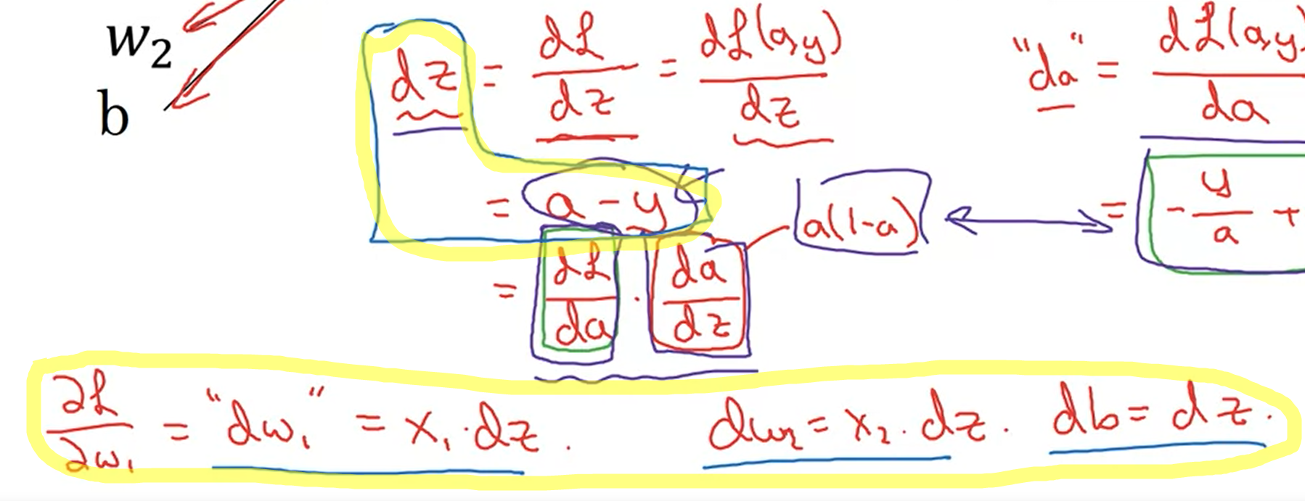
Logistic regression derivatives 4
Notes:
If we want to do gradient descent w.r.t to just these 2 variables we will use the
Dz = a-y
&
Dl/dw1 = x1.dz & dw2 = x2.dz formulas.
& than we update the values of weights using formulas listed in blue in next slide.

Slide 11




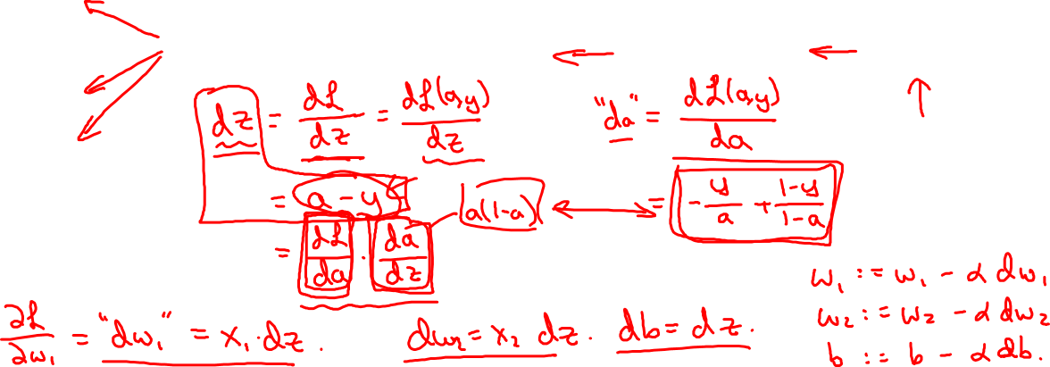



Logistic regression derivatives
$$x_{1}$$
$$w_{1}$$
$$x_{2}$$
$$z= w_{1}x_{1}+w_{2}x_{2}+b$$
$$a= σ(z)$$
$$ℒ(a,y)$$
$$w_{2}$$
b
Notes:
To update the weights we use the formulas written in the right side.
This is an example for 1 step for one training example.

Slide 12
Basics of Neural Network Programming
Gradient descent
on m examples
deeplearning.ai
Notes:
In reality we have many training examples. m

Slide 13
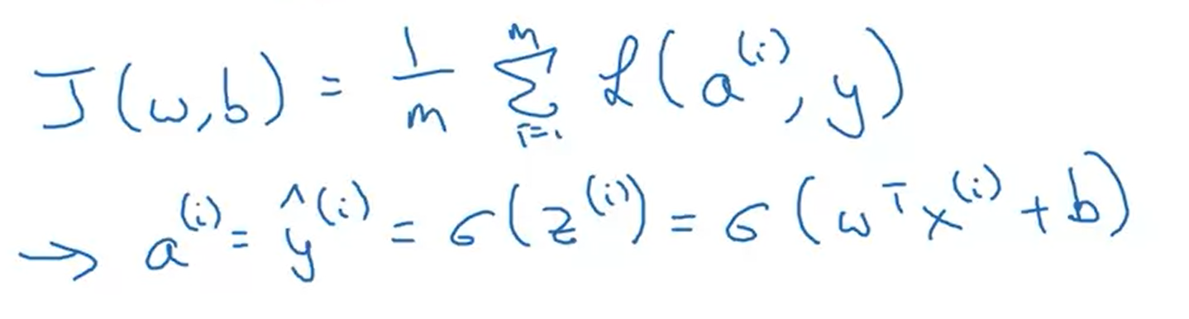
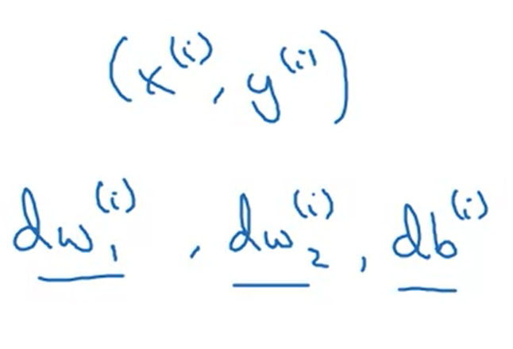
Revisiting Cost Function
Average of sum of loss for all examples.
Previously we computed the partial derivative of weights & bias for only one training example:
Notes:
Previously we only discussed loss function since we were only concerned about 1 training example.
Here let us do a recap for cost function.

Slide 14
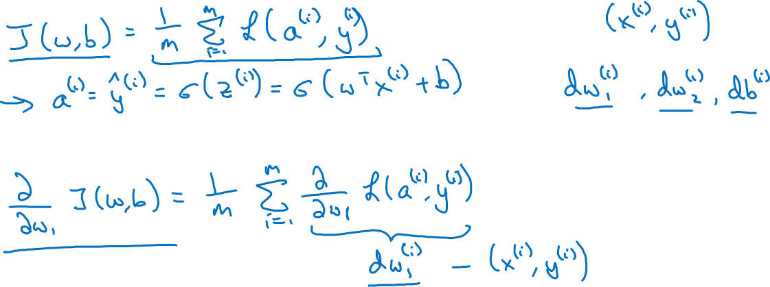
Logistic regression on m examples
Notes:
It turns out that the derivative of cost function with respect to our parameters is the average of derivatives of individual loss functions with respect to w1.
Previously we have shown how to compute the terms inside the loss function. We just need to compute the dw1 & average them which will give the overall gradient.

Slide 15
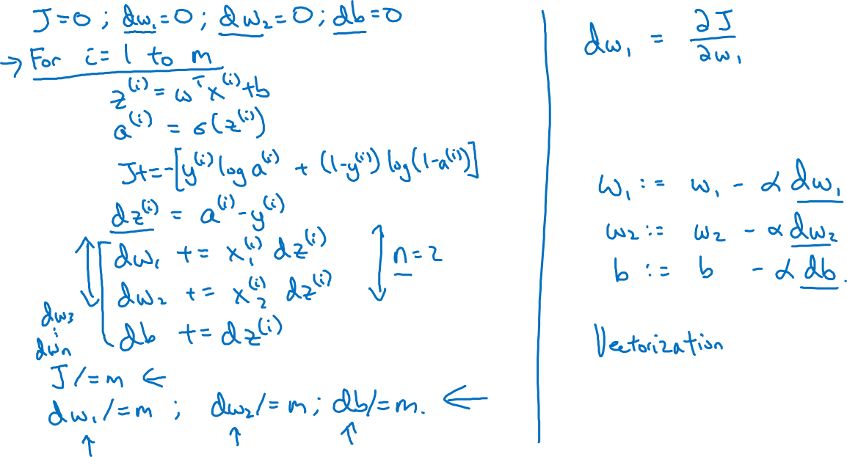
Logistic regression on m examples
Notes:
Here the dw1 & dw2 is shown for only two features, we do this calculations as many times as we have features.
At the end we divide by m.
The three variables declared outside the loop are acting as accumulators because we want to update the weights after seeing all the training examples.
2 weakness, = 2 for loops
One over m training example
One over all the features.
For loops are not good in NN, we use vectorization.

